Slide 1
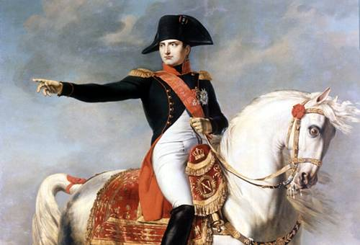
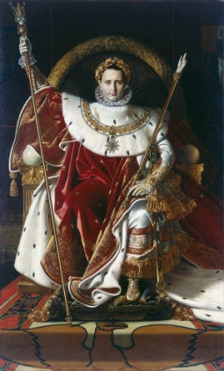
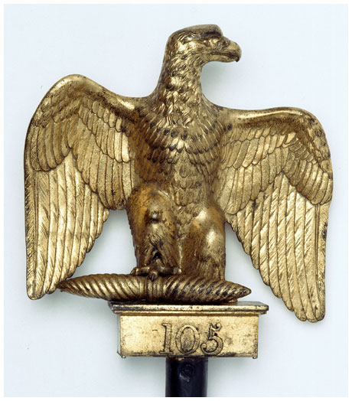
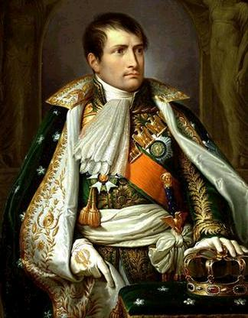
Chapter 19: The Age of Napoleon & the Triumph of Romanticism

Slide 2
Chapter 19: The Age of Napoleon & the Triumph of Romanticism
Upon completion of this unit students will be able to:
Discuss Napoleon's rise to power and explain how he was able to become Emperor.
Identify Napoleon's administrative reforms and understand how they differed from Old Regime policies.
Trace France's military conquests, the establishment of the French Empire, and European resistance to France.
Explain Napoleon's reasons for invading Russia and understand how the failed invasion marked the beginning of his downfall.
Discuss the Congress of Vienna and its significance.
Differentiate between Romanticism and the Enlightenment and explain why Romanticism thrived during the Napoleonic Age.

Slide 3
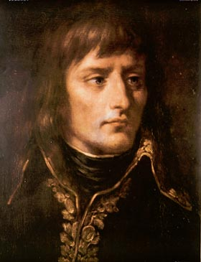
The Rise of Napoleon Bonaparte Section 1
What challenges did the Directory face?
How and why did the Republic make itself dependent on the army?
How was Napoleon able to use his victories in Italy and the later invasion of Egypt to set up a coup d’etat in France?
How was Napoleon able to put out a Constitution in 1799?
What does Napoleon’s early life and career tell you about him?

Slide 4
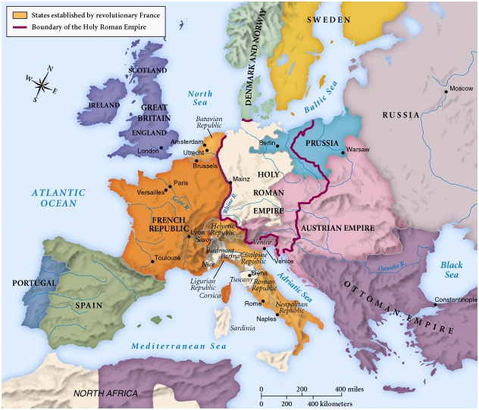
Europe in 1800

Slide 5
The Consulate in France Section 2
What talents of leadership did Napoleon possess that gave him the support of most Frenchmen? Was he the last enlightened despot or the first modern tyrant?
How did Napoleon use plebiscites to gain public support for his régime & policies?
How did Napoleon establish peace in Europe & France between 1799-1802?
What did Napoleon gain by the Concordat with the Vatican in 1801?
What were the major aspects of the Napoleonic Code?
How did Napoleon concoct of use real plots on his life to gain power & proclaim himself Emperor of the French in 1804?
With the Revolution over, & with himself crowned Emperor Napoleon I, what did Napoleon intend to do with him powerful new state? What made France so powerful under the new Emperor?

Slide 6
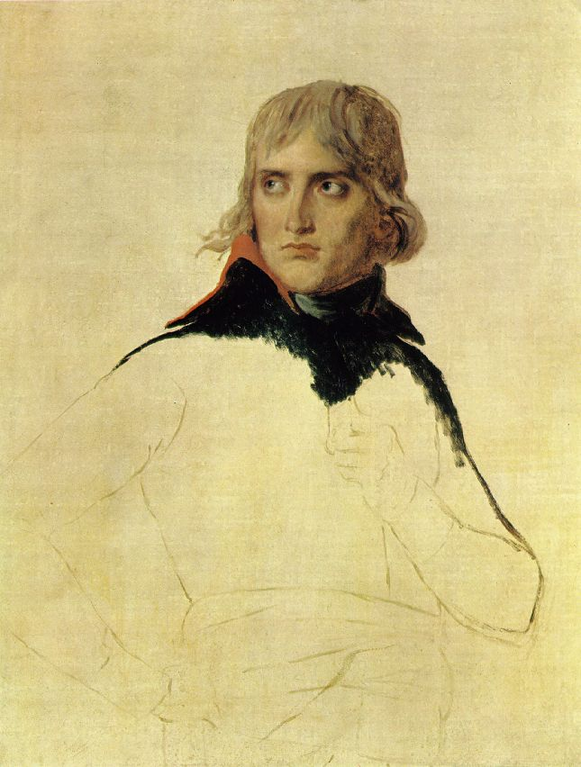
“Bonaparte,” 1798
Jacques Louis David
FIRST CONSUL

Slide 7
Napoleon’s Empire 1804-1814 Section 3
Why couldn’t any single nation match French military resources? How did this lead to coalitions?
What was the significance of the Treaty of Campo Formio for the German States and Austria?
What three states joined in the Third Coalition against Napoleon in 1805? Why did Czar Alexander I join the coalition?
What was the significance of Lord Nelson’s naval victory at Trafalgar?
What was the impact of the following battles: Austerlitz, Jena, Auerstädt?
What were the terms of the Treaty of Tilsit in 1807?
What was Napoleon’s Continental System as established by the Berlin Decrees in 1806?

Slide 8
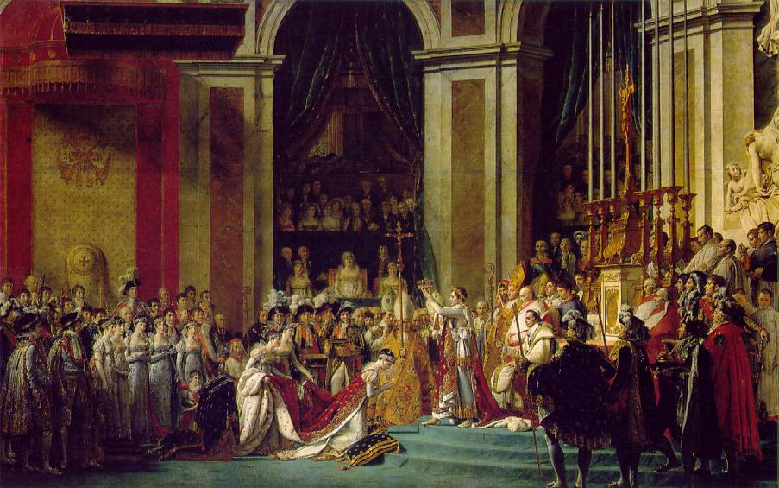
“Consecration of the Emperor Napoleon & the Empress Josephine,” 1806 by David
December 2, 1804

Slide 9
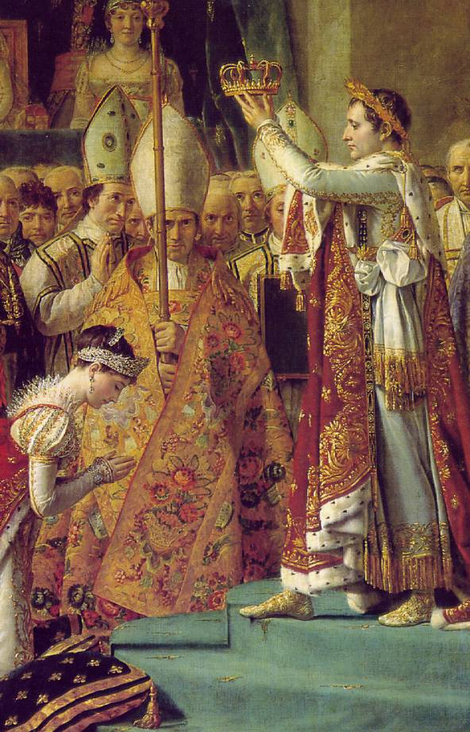
“Consecration of the Emperor Napoleon & the Empress Josephine,”
1806 by David

Slide 10
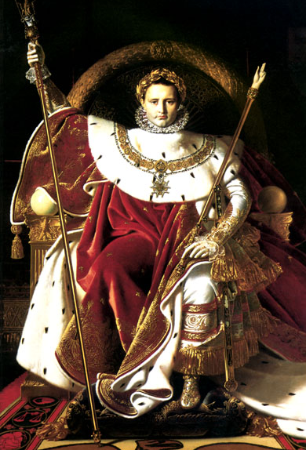
“Napoleon on His Imperial Throne”
1806
By Jean Auguste Dominique Ingres

Slide 11
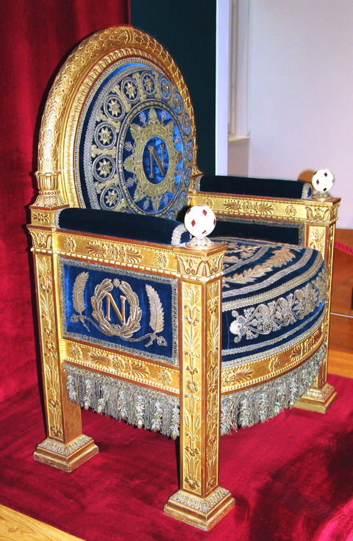
Napoleon’s Throne

Slide 12
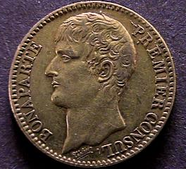
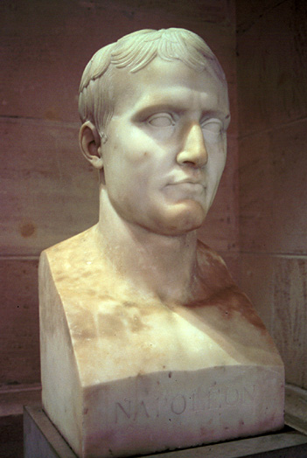
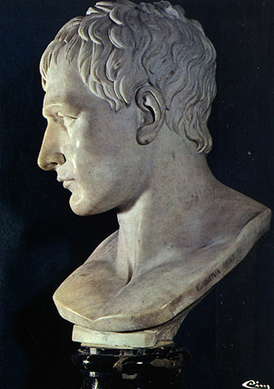
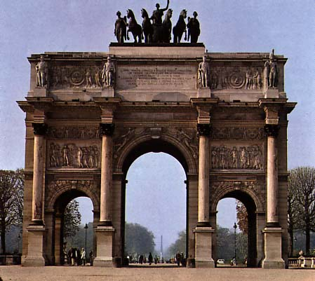
The Imperial Image

Slide 13
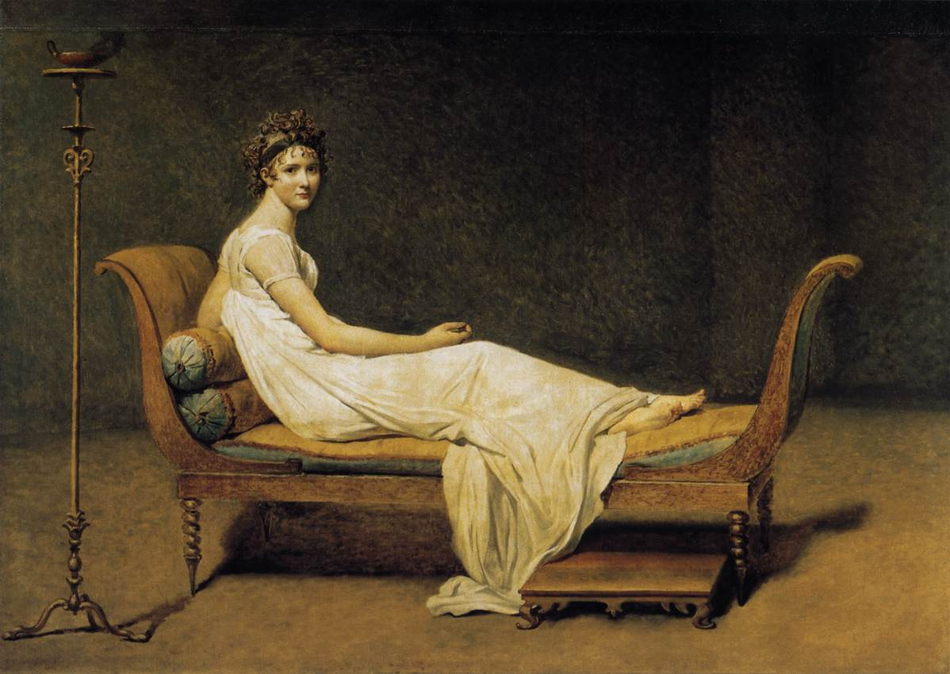
The “Empire” Style
Madame Recamier by David, 1808

Slide 14
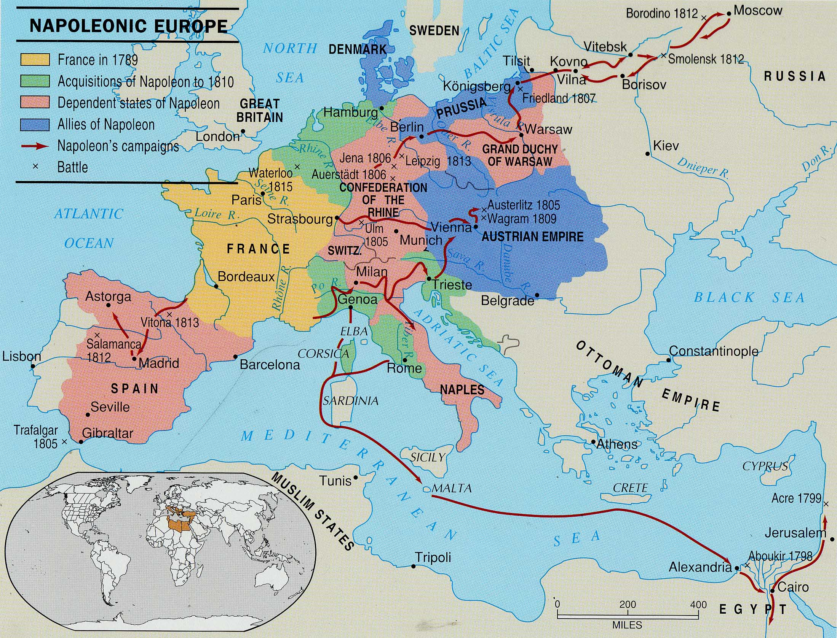
Napoleonic Europe

Slide 15
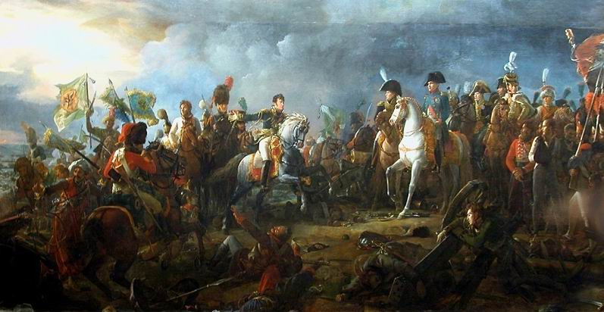
The Battle of Austerlitz
Napoleon at the Battle of Austerlitz by Francois Gerand
Napoleon’s Greatest Victory
December 2, 1805

Slide 16
The Battle of Austerlitz
In one day Emperor Napoleon destroyed the combined armies of the Austrian & Russian Empires & ended the 3rd Coalition
French Empire at Austerlitz
Strength: 65,000
Casualties & Losses: 1,305 dead, 6,940 wounded, 1 standard lost
Austrian & Russian Empires at Austerlitz
Strength: 95,000-110,000
Casualties & Losses: 15,000 dead, 11,000 wounded, 12,000 captured, 50 standards lost!
Holy Roman Empire is dissolved!

Slide 17
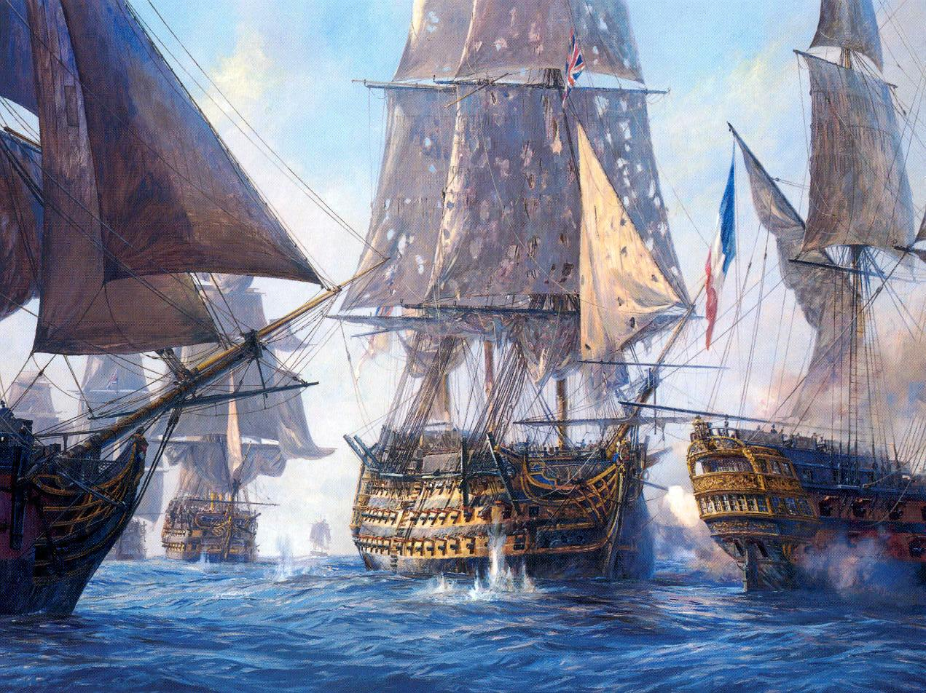
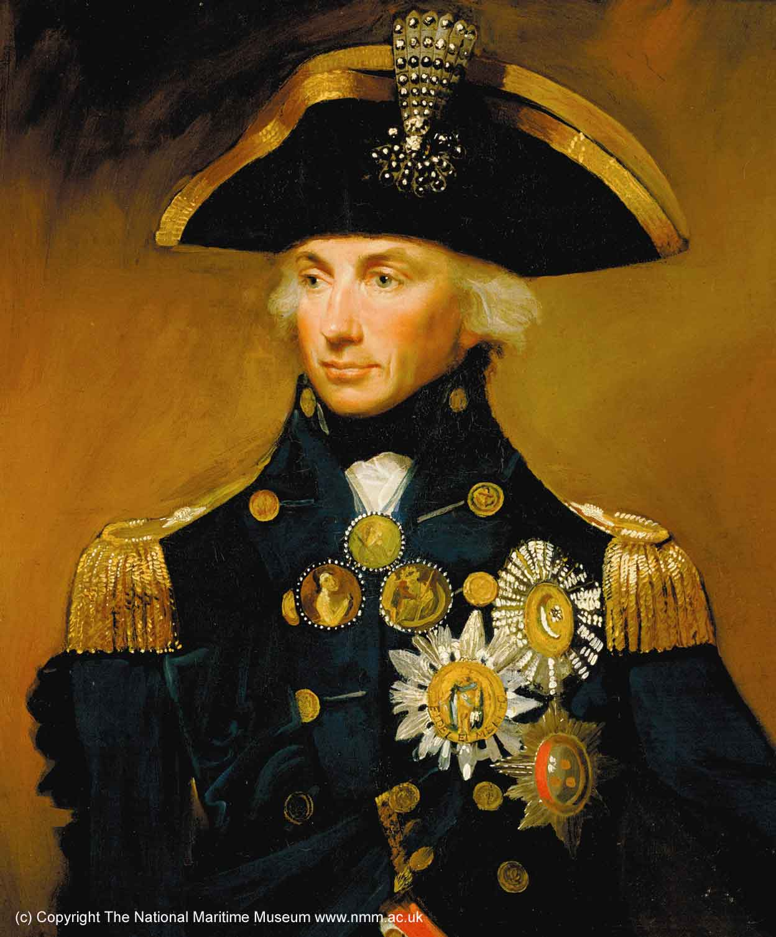
Napoleon’s Major Military Campaigns
Sea Power
1805:
France →
← Britain
Trafalgar (Lord Nelson: Fr. Navy lost!)

Slide 18
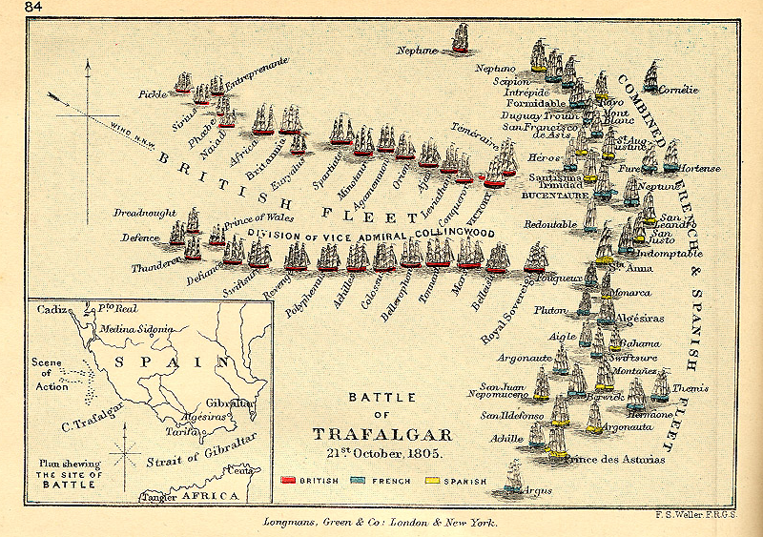
Battle of Trafalgar

Slide 19
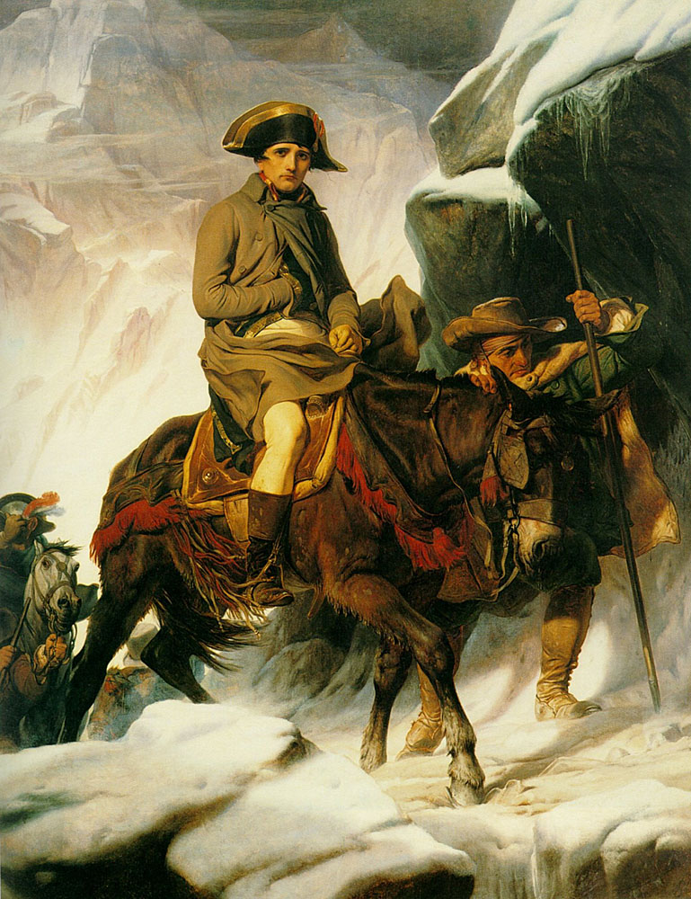
“Crossing the Alps,”
1805
Paul Delaroche

Slide 20
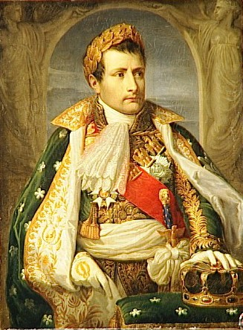
Napoleon’s Major Military Campaigns
-Danube -Italy
1805:
France →
← Britain Austria Russia (3rd Coalition)
ULM: France defeated Austria.
AUSTERLITZ: France defeated Austria & Russia.
Crowned “King of Italy” on May 6, 1805

Slide 21
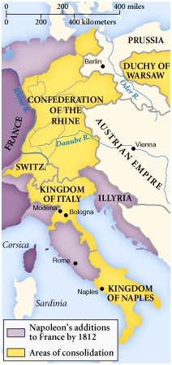
Napoleon’s Major Military Campaigns
Confed. of the Rhine
1806:
France →
← Prussia
JENA: French Troops in Berlin!
BERLIN DECREES (“Continental System”)
4th Coalition created

Slide 22
British Cartoon
“Continental System” (1806-1812)

Slide 23
Napoleon’s Major Military Campaigns
Poland
1806:
France →
← Russia
Grand Duchy of Warsaw
FRIEDLAND: France defeated Russian troops
: France occupied Konigsberg, capital of East Prussia!

Slide 24
European Response to the Empire Section 4
What powerful political forces did Napoleon’s conquests unleash across Europe? How did they forever transform Europe?
What caused the rise of nationalist resistance to Napoleon’s empire? Why was the battle of Jena important to this?
Why did a defeated Prussia become a rallying point for German nationalists? What reforms did a humiliated Prussia pursue to regain its lost power?
What provoked Napoleon to invade Spain in 1807? What transpired after this invasion to arouse Spanish resistance? What type of warfare did Napoleon face for the first time during the Spanish campaign?
What was the result of Austria seeking a war of revenge against Napoleon in 1809?
Why did Czar Alexander I turn against Napoleon after 1809?
Why was Napoleon’s invasion of Russia a failure?
Why did Napoleon reject peace overtures from Austrian foreign minister Prince Klemens von Metternich? What resulted from his failure to compromise?

Slide 25
Coalitions Against Napoleon
The 1st Coalition 1792-1797
Austria, Prussia, Great Britain, Spain, Piedmont.
The 2nd Coalition 1798-1801
Russia, Britain, Austria, Ottoman Empire, Portugal, Naples, Vatican.
The 3rd Coalition 1805
Austria, Great Britain, Russia, Sweden.
The 4th Coalition 1806-1807
Prussia, Saxony, Russia.
The 5th Coalition 1809
Great Britain and Austria.
The 6th Coalition 1812-1814
Great Britain and Russia, joined by Prussia, Sweden, Austria, German States.
The 7th Coalition 1815
Great Britain, Russia, Prussia, Sweden, Austria, German States.

Slide 26
Josephine’s Divorce Statement (1807)
With the permission of our august and dear husband, I must declare that, having no hope of bearing children who would fulfill the needs of his policies and the interests of France, I am pleased to offer him the greatest proof of attachment and devotion ever offered on this earth.

Slide 27
Napoleon’s Divorce Statement (1807)
Far from ever finding cause for complaint, I can to the contrary only congratulate myself on the devotion and tenderness of my beloved wife. She has adorned thirteen years of my life; the memory will always remain engraved on my heart.

Slide 28
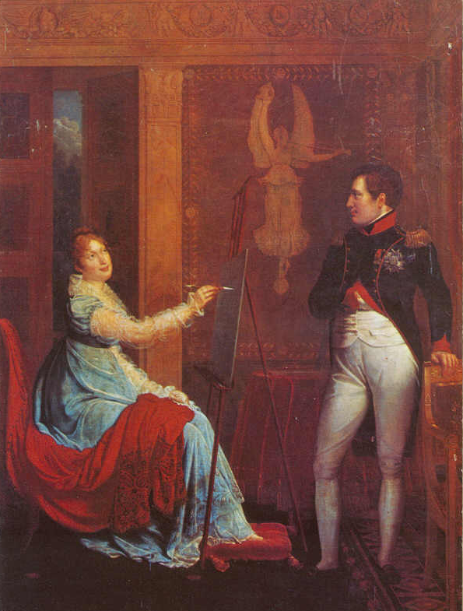
Marie Louise (of Austria) married Napoleon on March 12, 1810 in Vienna

Slide 29
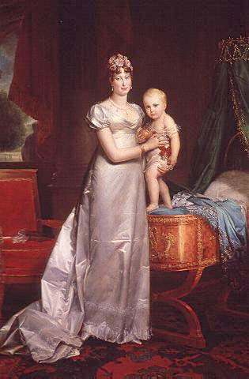
Marie Louise (of Austria) with Napoleon’s Son
(Napoléon Francis Joseph Charles: 1811-1832)

Slide 30
Peninsular Campaign: 1807-1810
Continental System
1806:
France →
← Spain Portugal
Portugal did not comply with the Continental System.
France wanted Spain’s support to invade Portugal.
Spain refused, so Napoleon invaded Spain as well!

Slide 31
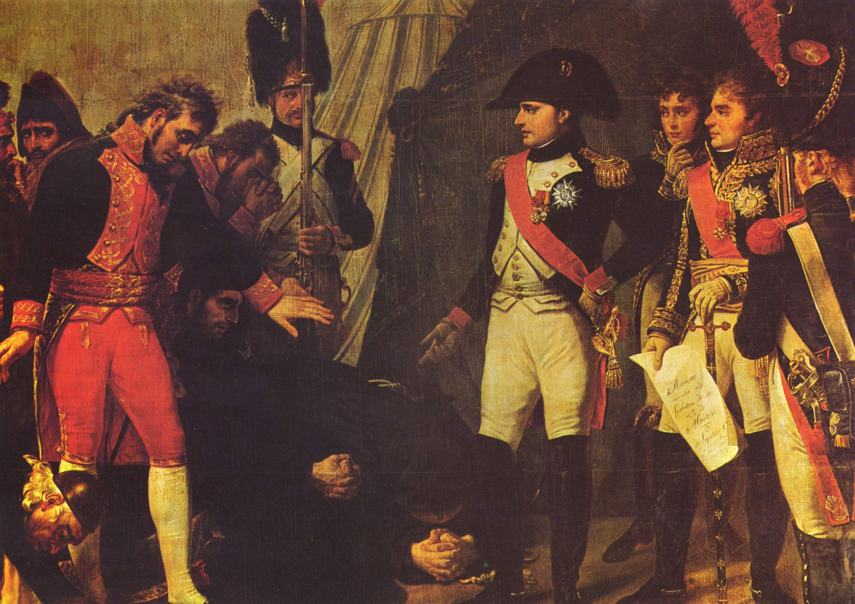
The Surrender of Madrid May, 1809

Slide 32
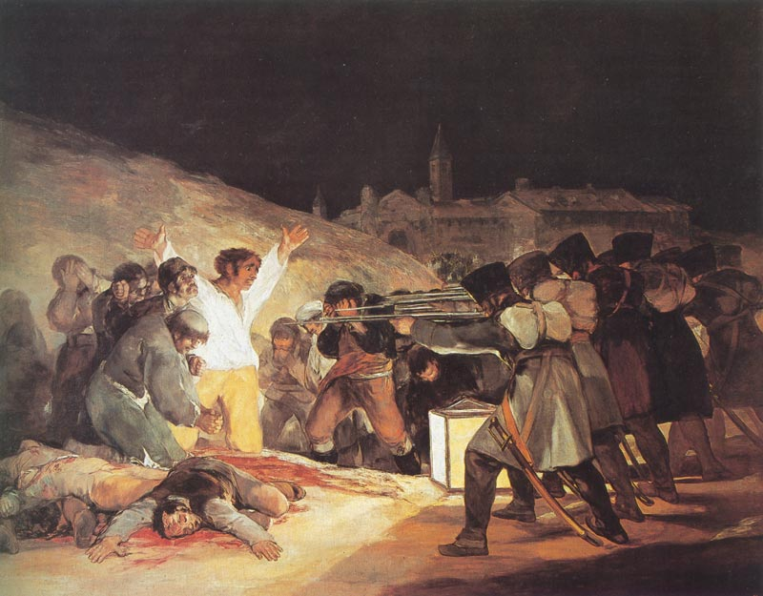
“Third of May, 1808” by Goya (1810)

Slide 33
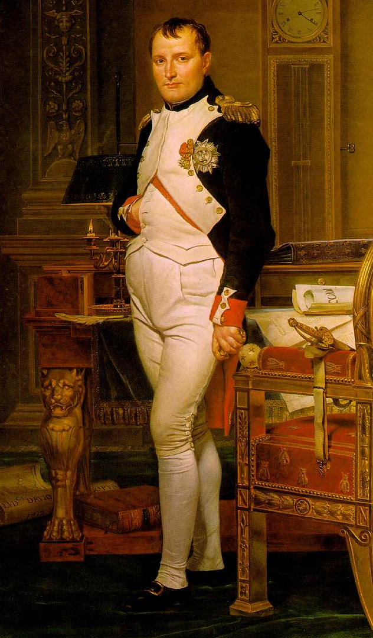
“Napoleon in His Study”
1812
by David

Slide 34
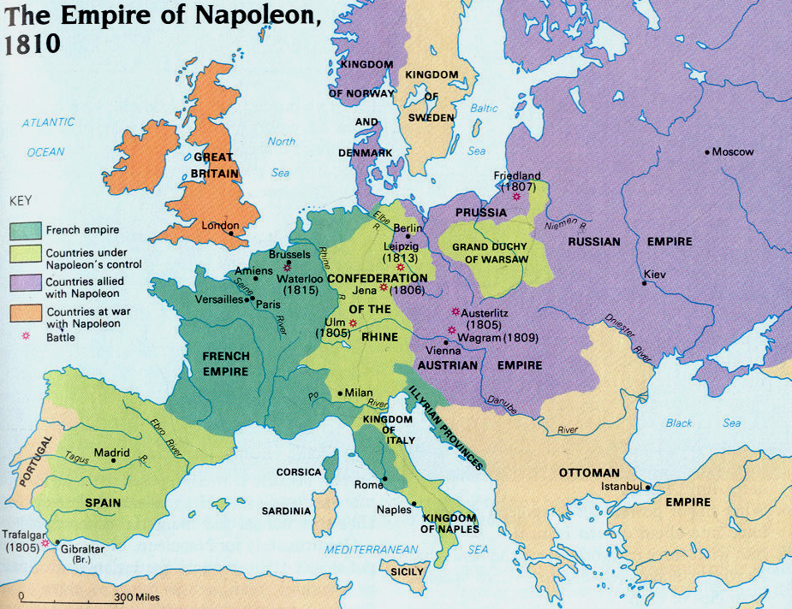
Napoleon’s Empire in 1810

Slide 35
Napoleon’s Family Rules!
Jerome Bonaparte → King of Westphalia.
Joseph Bonaparte → King of Spain
Louise Bonaparte → King of Holland
Pauline Bonaparte → Princess of Italy
Napoléon Francis Joseph Charles (son)→ King of Rome
Elisa Bonaparte → Grand Duchess of Tuscany
Caroline Bonaparte → Queen of Naples

Slide 36
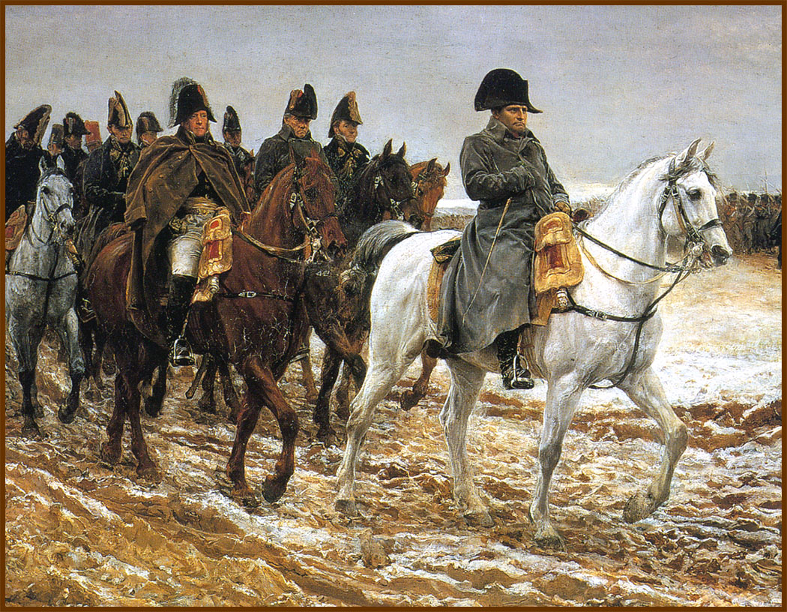
Napoleon Invades Russia: 1812
614,000 French troops

Slide 37
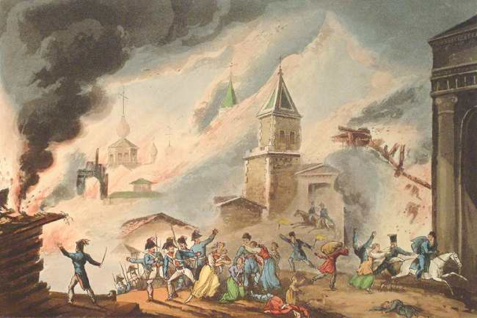
Moscow on Fire!

Slide 38
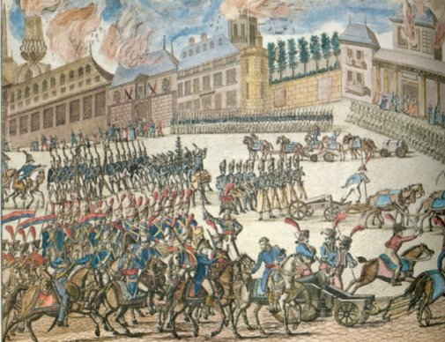
Napoleon & His Grand Armee at the Gates of Moscow

Slide 39
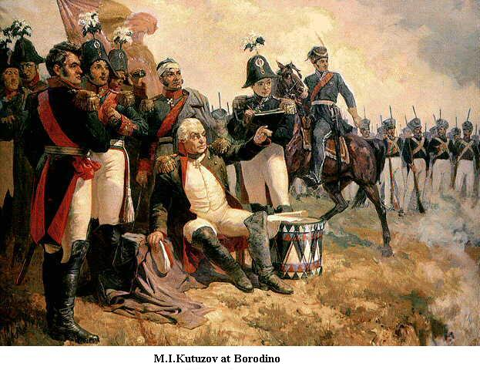
Russian General Kutuzov
The Russian army defeated the French at Borodino.

Slide 40
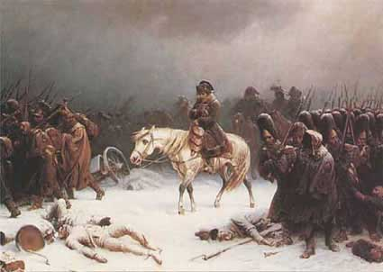
Napoleon’s Retreat from Moscow (Early 1813)
100,000 French troops retreat—40,000 survive!

Slide 41
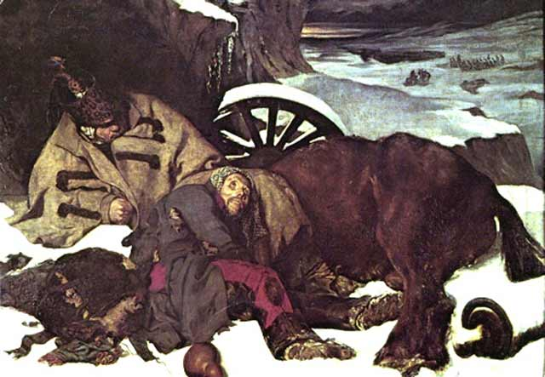
The 6th Coalition
Napoléon’s Defeat
1813-1814:
France →
← Britain, Russia. Spain, Portugal, Prussia, Austria, Sweden, smaller German states

Slide 42
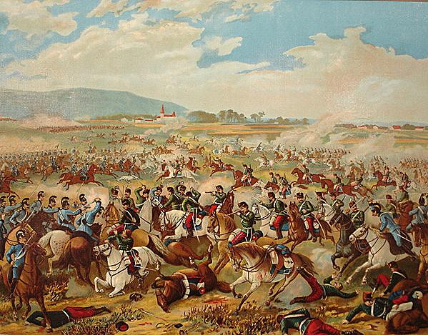
Battle of Dresden (Aug., 26-27, 1813)
Coalition → Russians, Prussians, Austrians.
Napoléon’s forces regrouped with Polish reinforcements.
100,000 coalition casualties; 30,000 French casualties.
French victory.

Slide 43
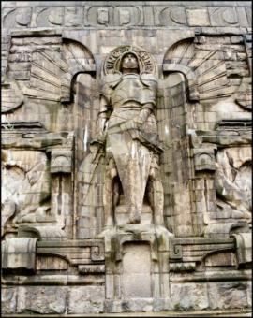
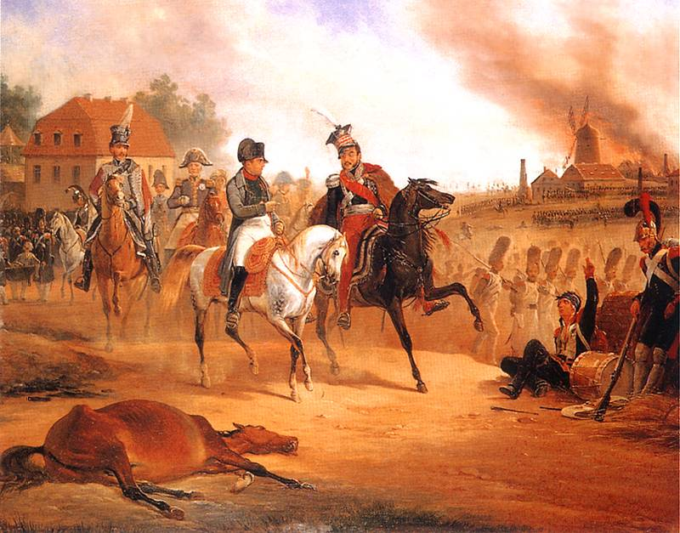
Napoleon’s Defeat at Leipzig (October 16-17, 1813)
“Battle of the Nations” Memorial

Slide 44
Napoleon Abdicates!
Allied forces occupied Paris on March 31, 1814.
Napoléon abdicated on April 6 in favor of his son, but the Allies insisted on unconditional surrender.
Napoléon abdicated again on April 11.
Treaty of Fontainbleau → exiles Napoléon to Elba with an annual income of 2,000,000 francs.
The royalists took control and restored Louis XVIII to the throne.

Slide 45
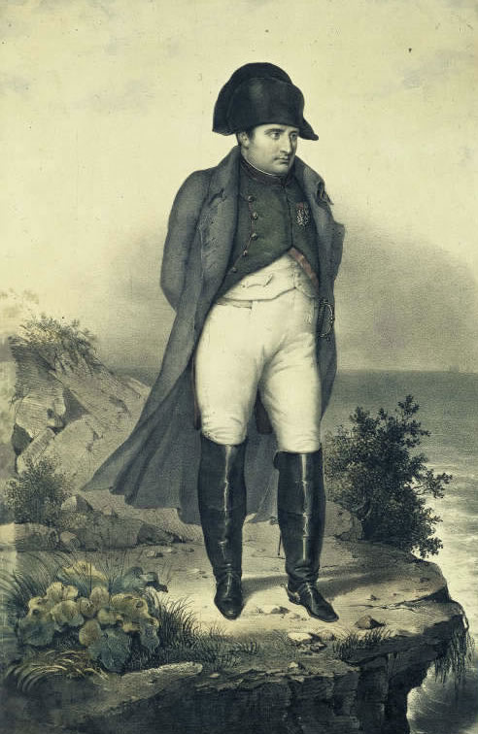
Napoleon in Exile on Elba

Slide 46
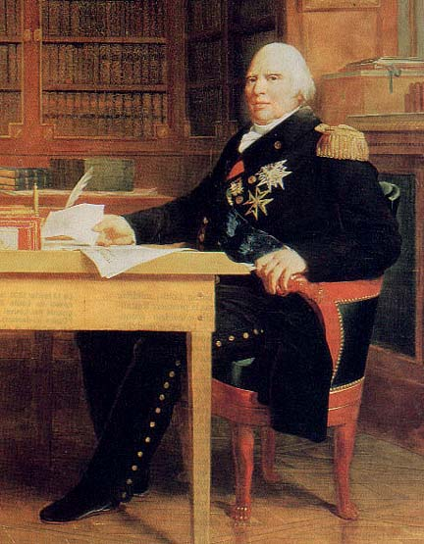
Louis XVIII (r. 1814-1824)

Slide 47
“The War of the 7th Coalition”
Napoleon’s “100 Days”
1815:
France →
← Britain, Russia. Prussia, Austria, Sweden, smaller German states
Napoléon escaped Elba and landed in France on March 1, 1815 → the beginning of his 100 Days.
Marie Louise & his son were in the hands of the Austrians.

Slide 48
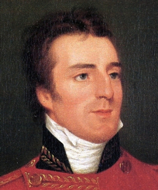
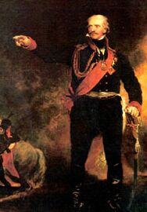
Napoleon’s Defeat at Waterloo (June 18, 1815)
Duke of Wellington Prus. General Blücher

Slide 49
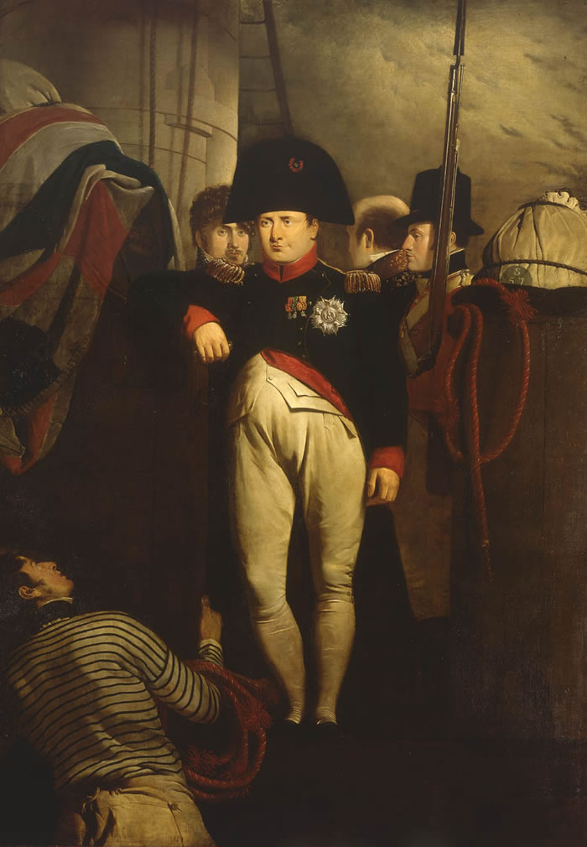
Napoleon on His Way to His Final Exile on St. Helena

Slide 50
Napoleon’s Tomb

Slide 51
What is Napoleon’s Legacy?

